Slide 1
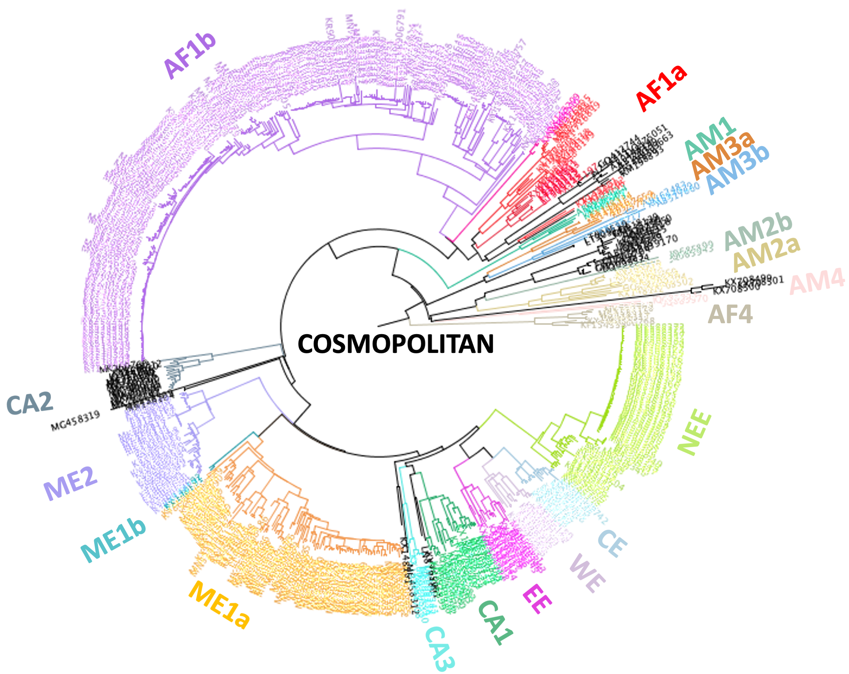
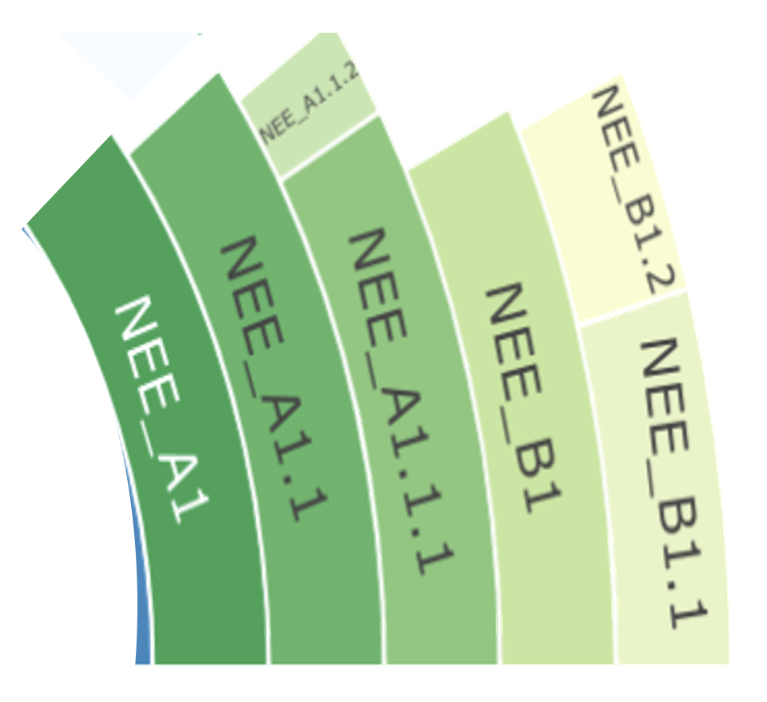
Clade
Subclade
Minor lineage
Major lineage
Notes:
Figure 1 - Definitions of clade and subclade from previous classification system, with subclade expanded to show definitions of major and minor lineages from updated classification system. Above part of figure adapted from Troupin et al. (2016)

Slide 2
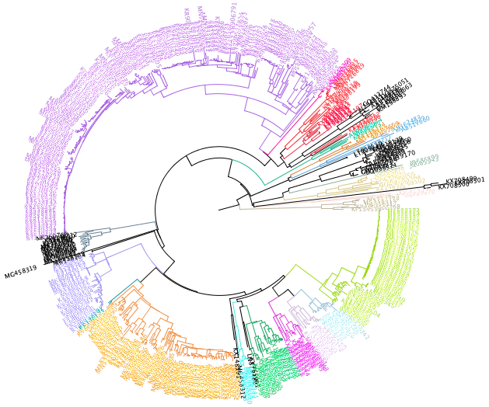
AF1b
AF1a
AM1
AM3a
AM3b
AM2b
AM2a
AM4
AF4
COSMOPOLITAN
CA2
NEE
ME2
ME1b
CE
WE
ME1a
EE
CA1
CA3

Slide 3
Sequences from GenBank
User input sequences
INPUT
Curation
Web interface to database
Reference alignments, trees and sequences
Input sequences compared to references
PROCESSING
Options to filter
Downloadable sequences, metadata and alignments
Genome visualization and comparison to reference
Clade assignment
Placement in phylogenetic tree
OUTPUT
Notes:
Figure 2 - Schematic of the online capabilities of RABV-GLUE including obtaining sequences from GenBank, options to filter and download sequences of interest, and phylogenetic interpretation of user input sequences.

Slide 4
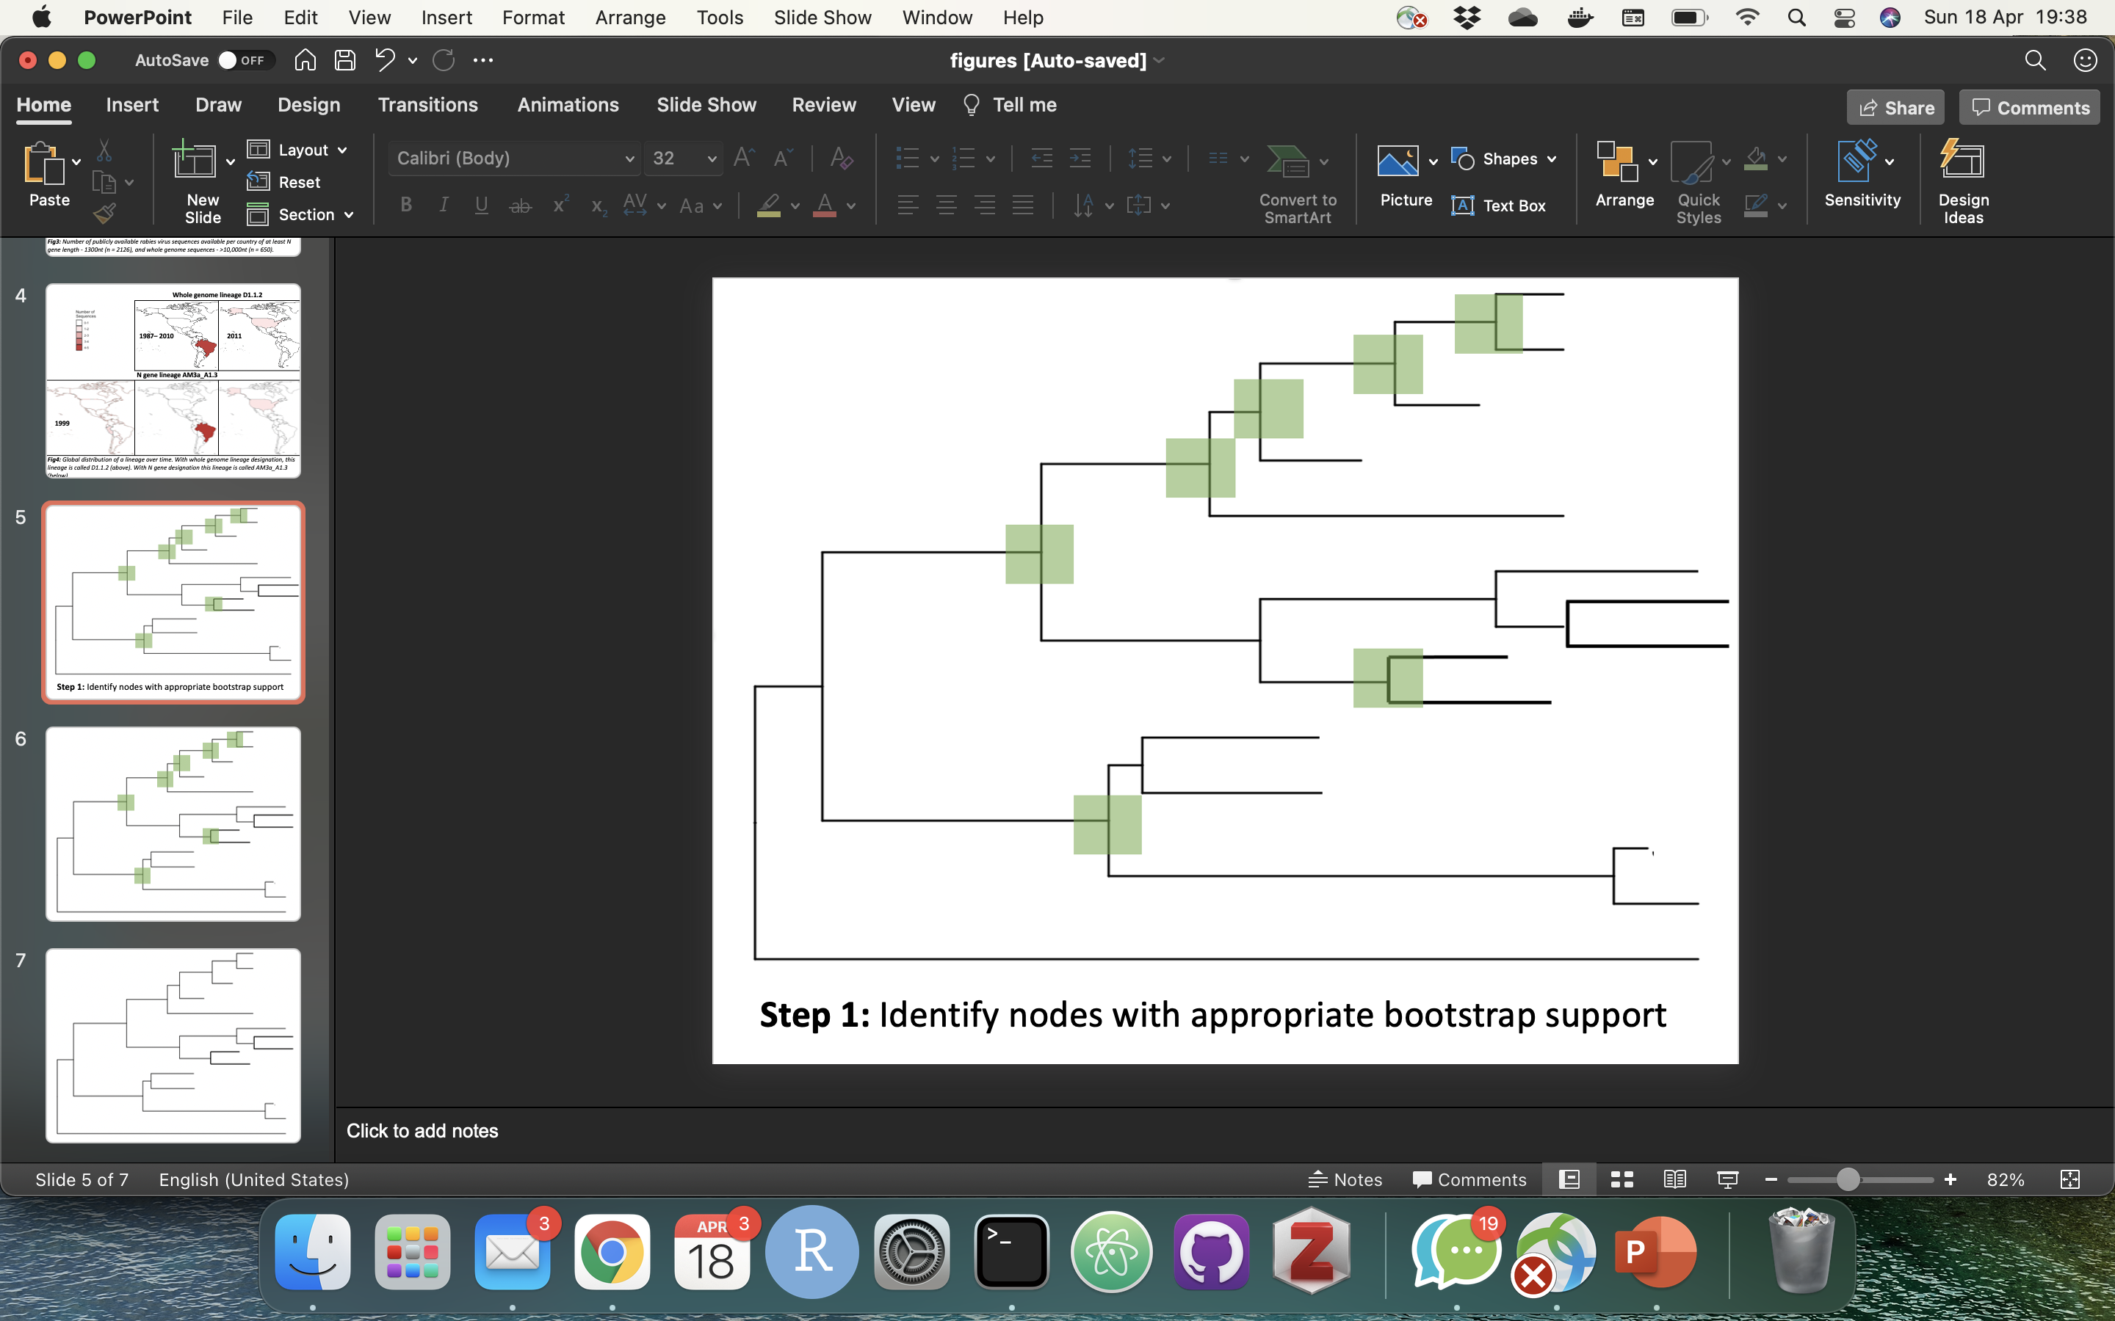
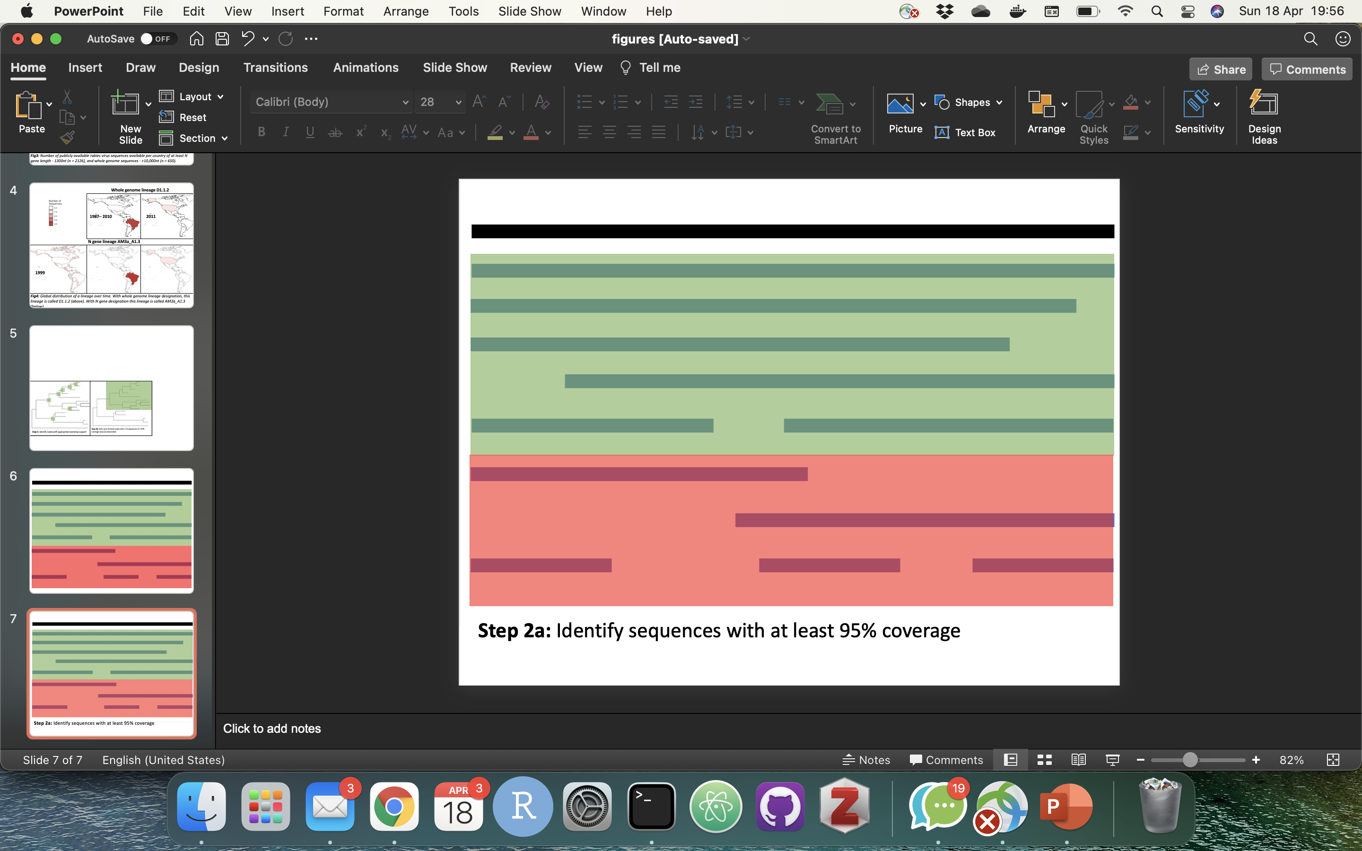
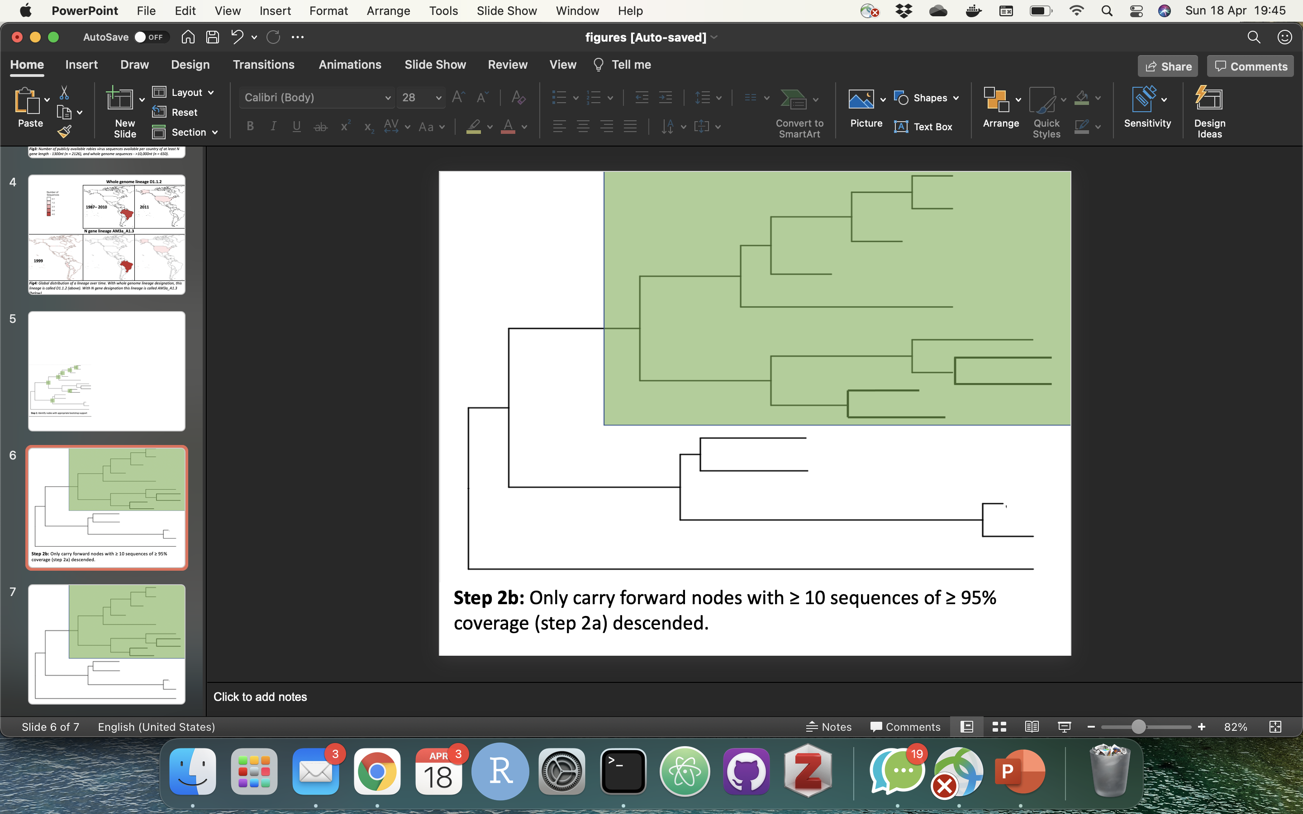
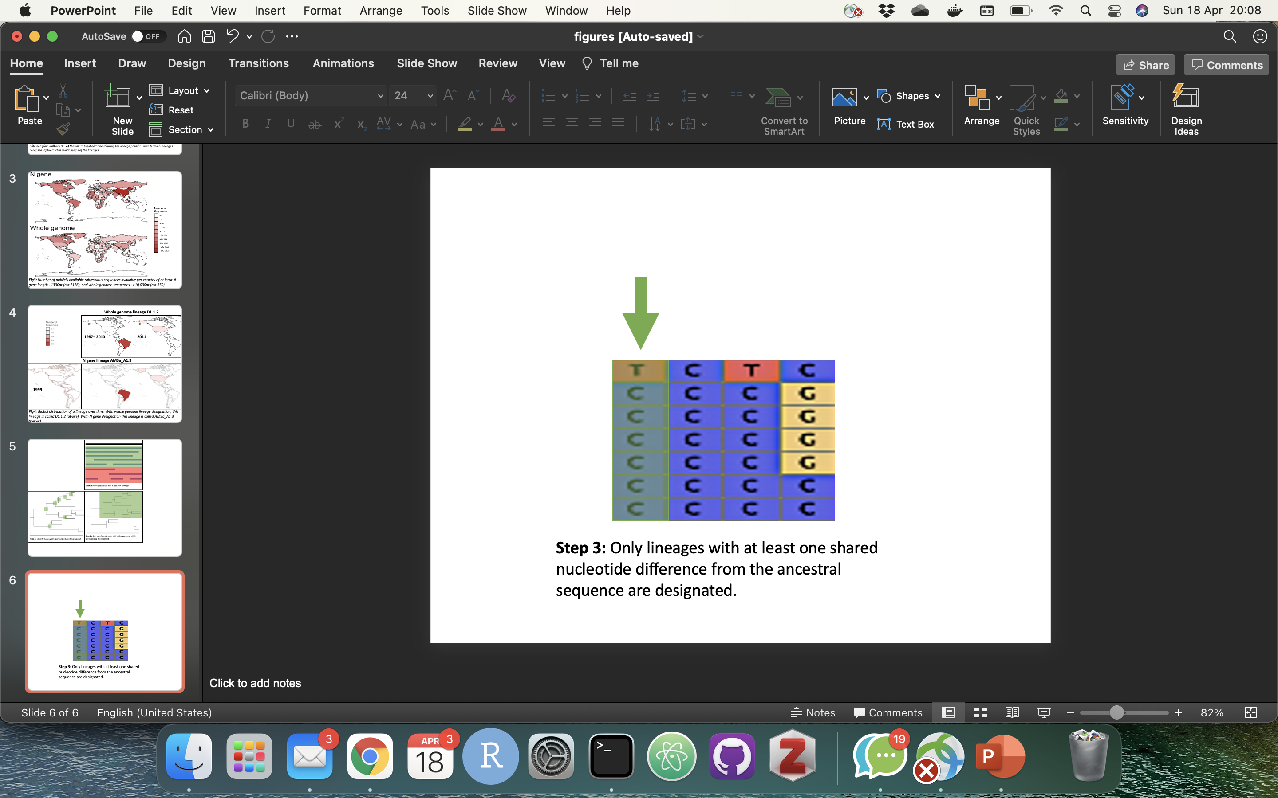
Step 4: Only lineages with at least one shared nucleotide difference from the ancestral sequence are designated
Step 1: Identify nodes with appropriate bootstrap support
Step 2: Identify sequences with at least 95% coverage
Step 3: Only carry forward nodes with ≥ 10 sequences of ≥ 95% coverage descended
Notes:
Figure 3 - Summary of lineage designation steps. Step 1 - Identify nodes with appropriate bootstrap support, Step 2 - Identify sequences with at least 95% coverage, Step 3 - Only carry forward nodes with at least 10 sequences of at least 95% coverage descended, Step 4 - Only lineages with at least one shared nucleotide difference from the ancestral sequence are designated.

Slide 5
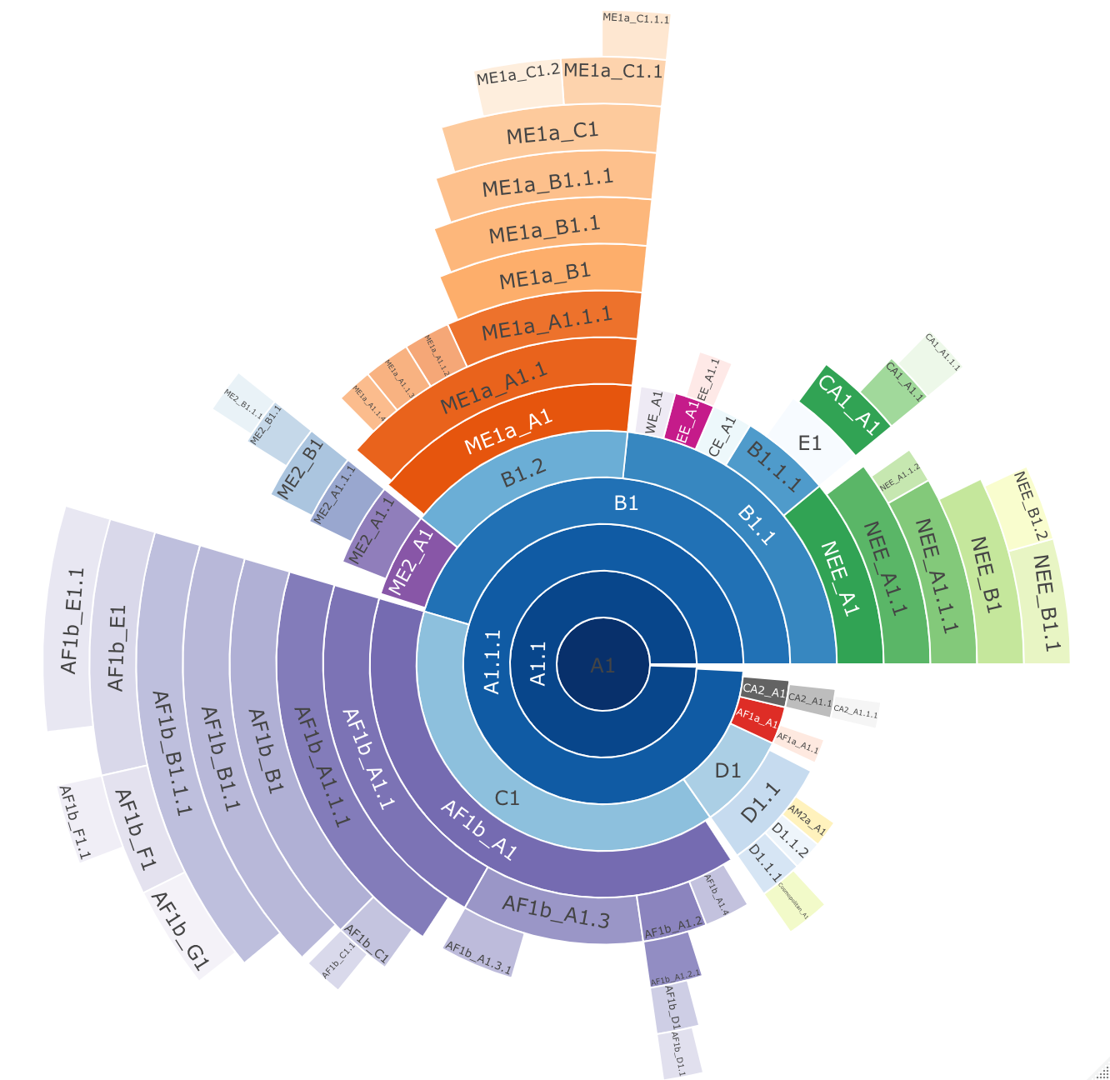
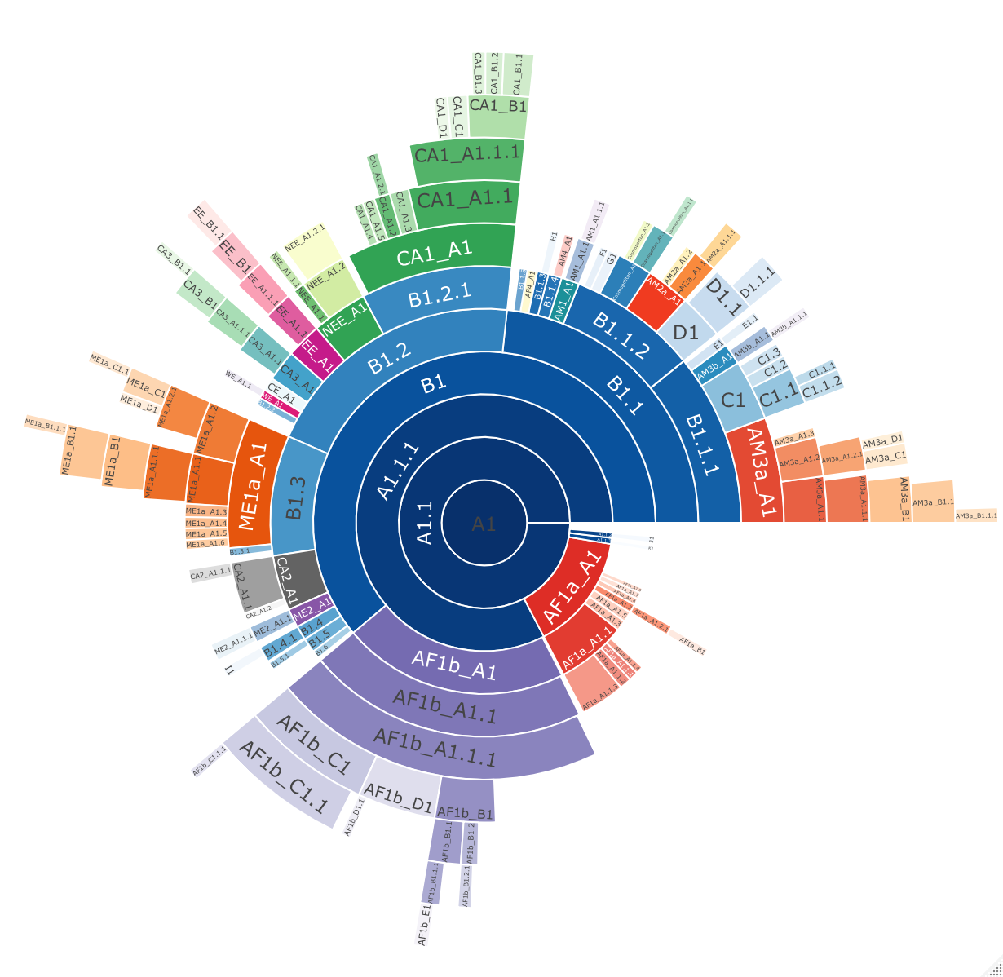
a)
b)
c)
d)
Notes:
Figure 4 - Lineage designation of 650 whole genome (10,000nt) rabies virus sequences from the Cosmopolitan clade, obtained from RABV-GLUE. A) Maximum likelihood tree showing the lineage positions with terminal lineages collapsed. B) Hierarchical relationships of the lineages. C) Proportions of lineages sequenced from each country. D) Lineage proportions zoomed in. Colours are comparable across all.

Slide 6
Number of sequences
1 - 5
6 - 10
11 - 25
26 - 50
51 - 100
101 - 200
>200
Notes:
1:5 = France
6:10 = China
11:25 = Russia
26:50 = S.Africa
51:100 = Hungary
101:200 = Iran
201+ = Tanzania

Slide 7
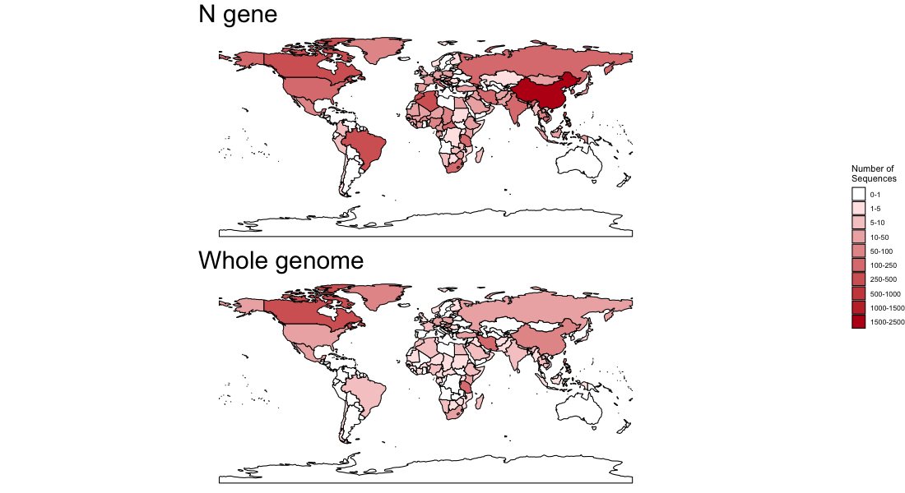
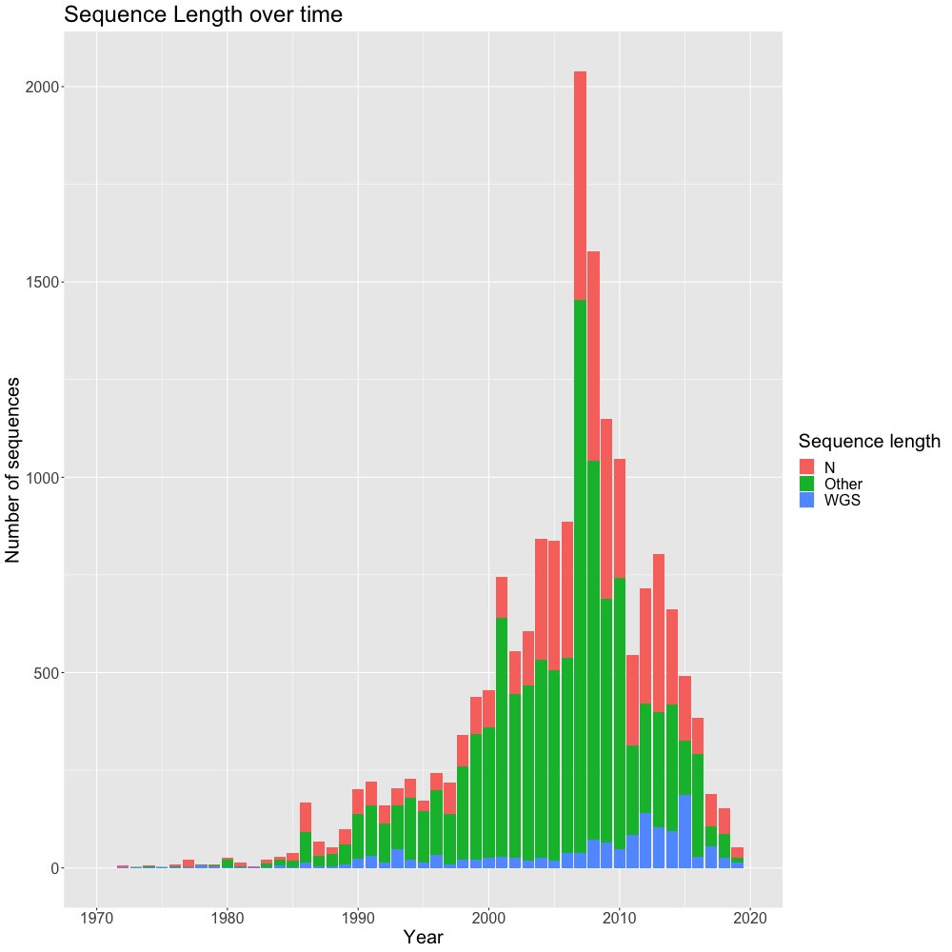
Notes:
Figure 5 – Left: Map of collection locations of all available whole genome and N gene sequences. Right: Time series of number of whole genome, N gene, and shorter sequences collected.

Slide 8
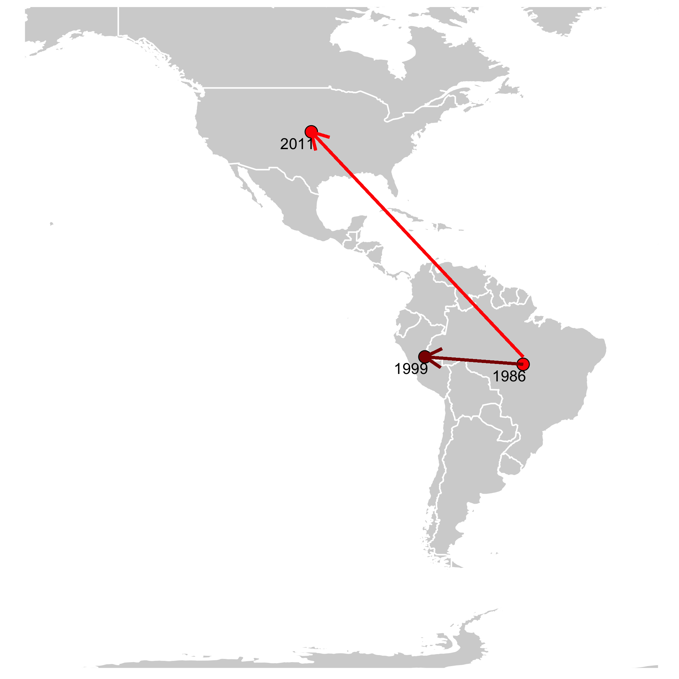
Notes:
Figure 7 - Global distribution of a lineage over time. Bright red indicates information from WGS lineage designation, whereas the darker red indicated the additional information from N gene lineage designation. Dated points represent introductions into countries, with arrows suggesting the likely route of introduction.

Slide 9
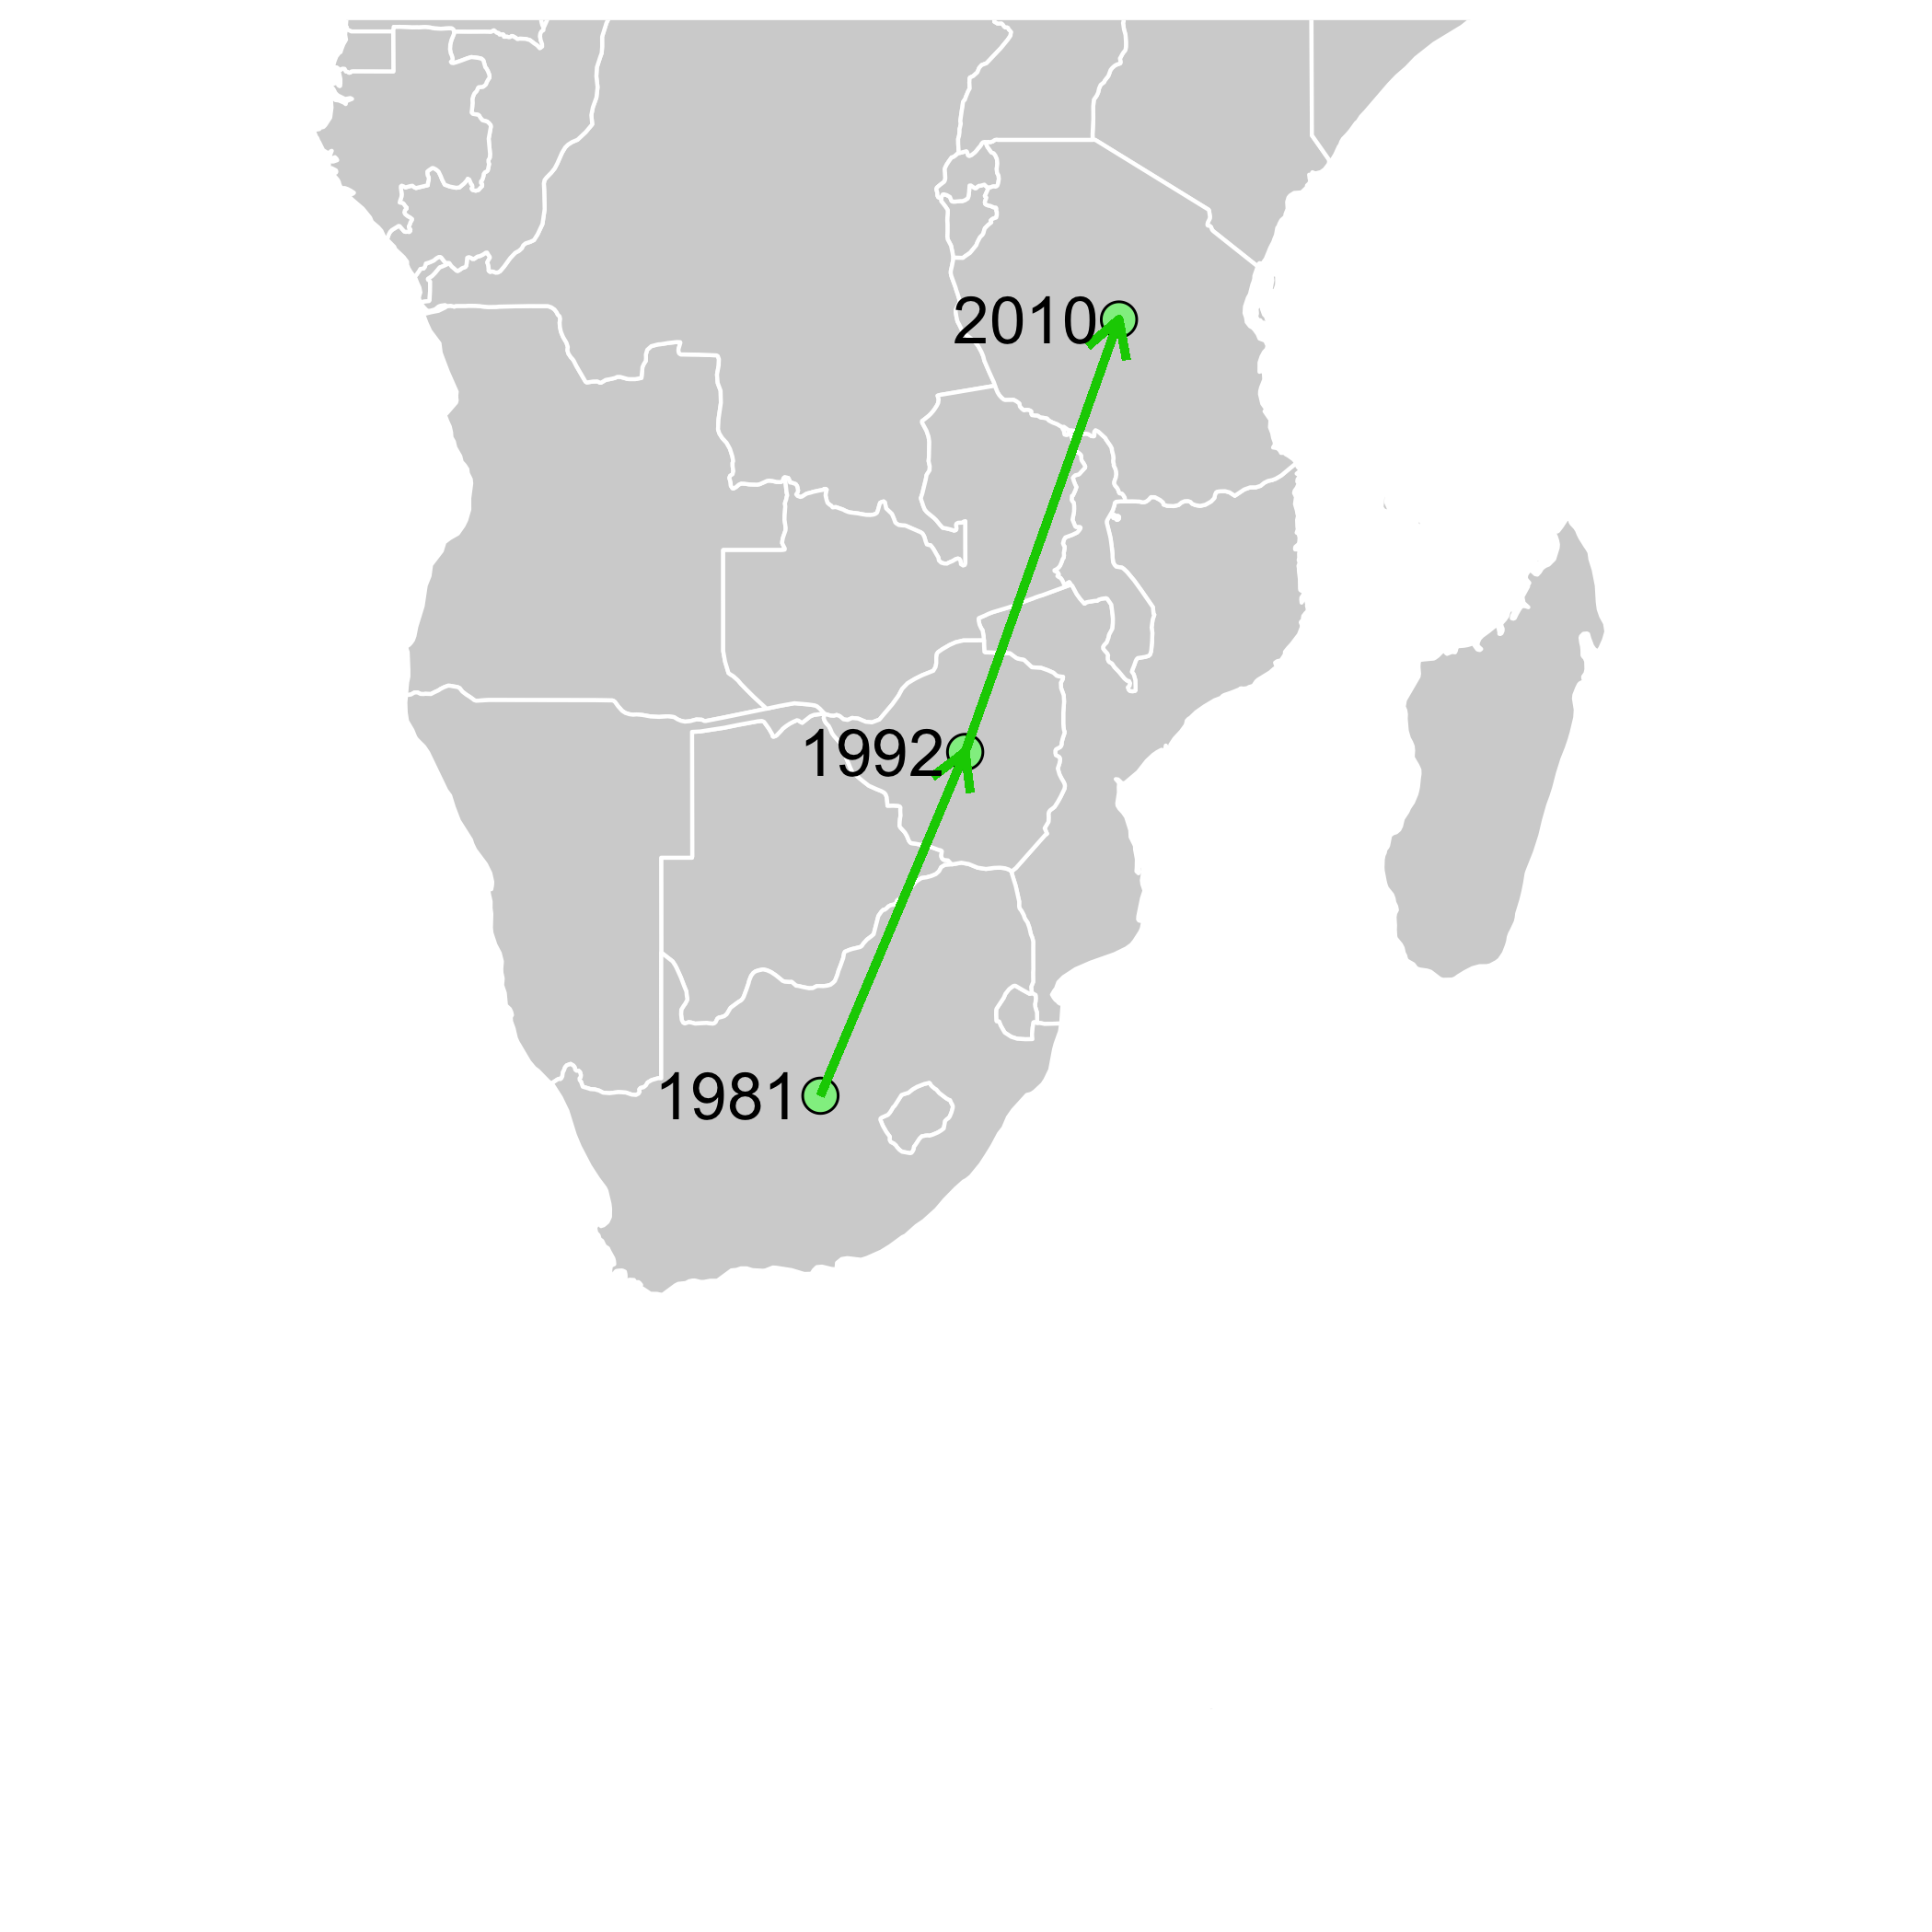
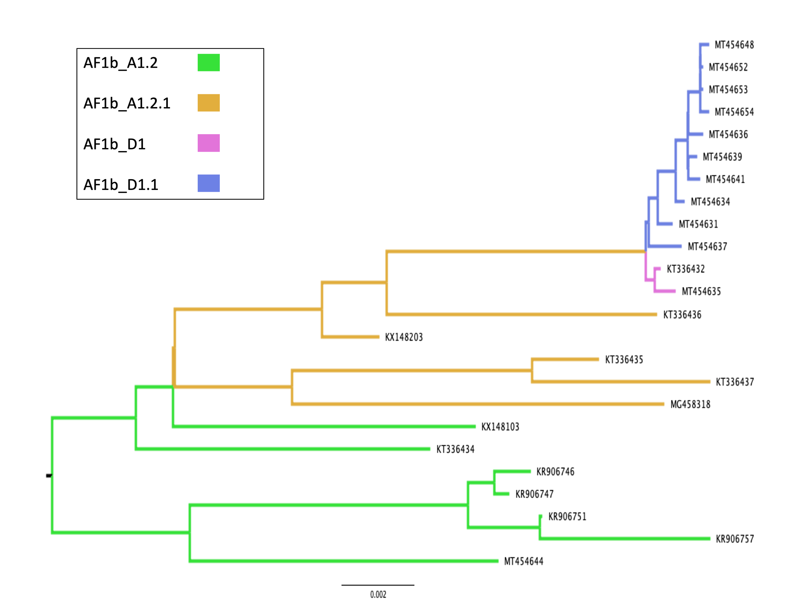
a)
b)
Notes:
Figure 8 - Global distribution of whole genome designated lineage AF1b_A1.2 over time (n=7) Dated points represent introductions into countries, with arrows suggesting the likely route of introduction.

Slide 10
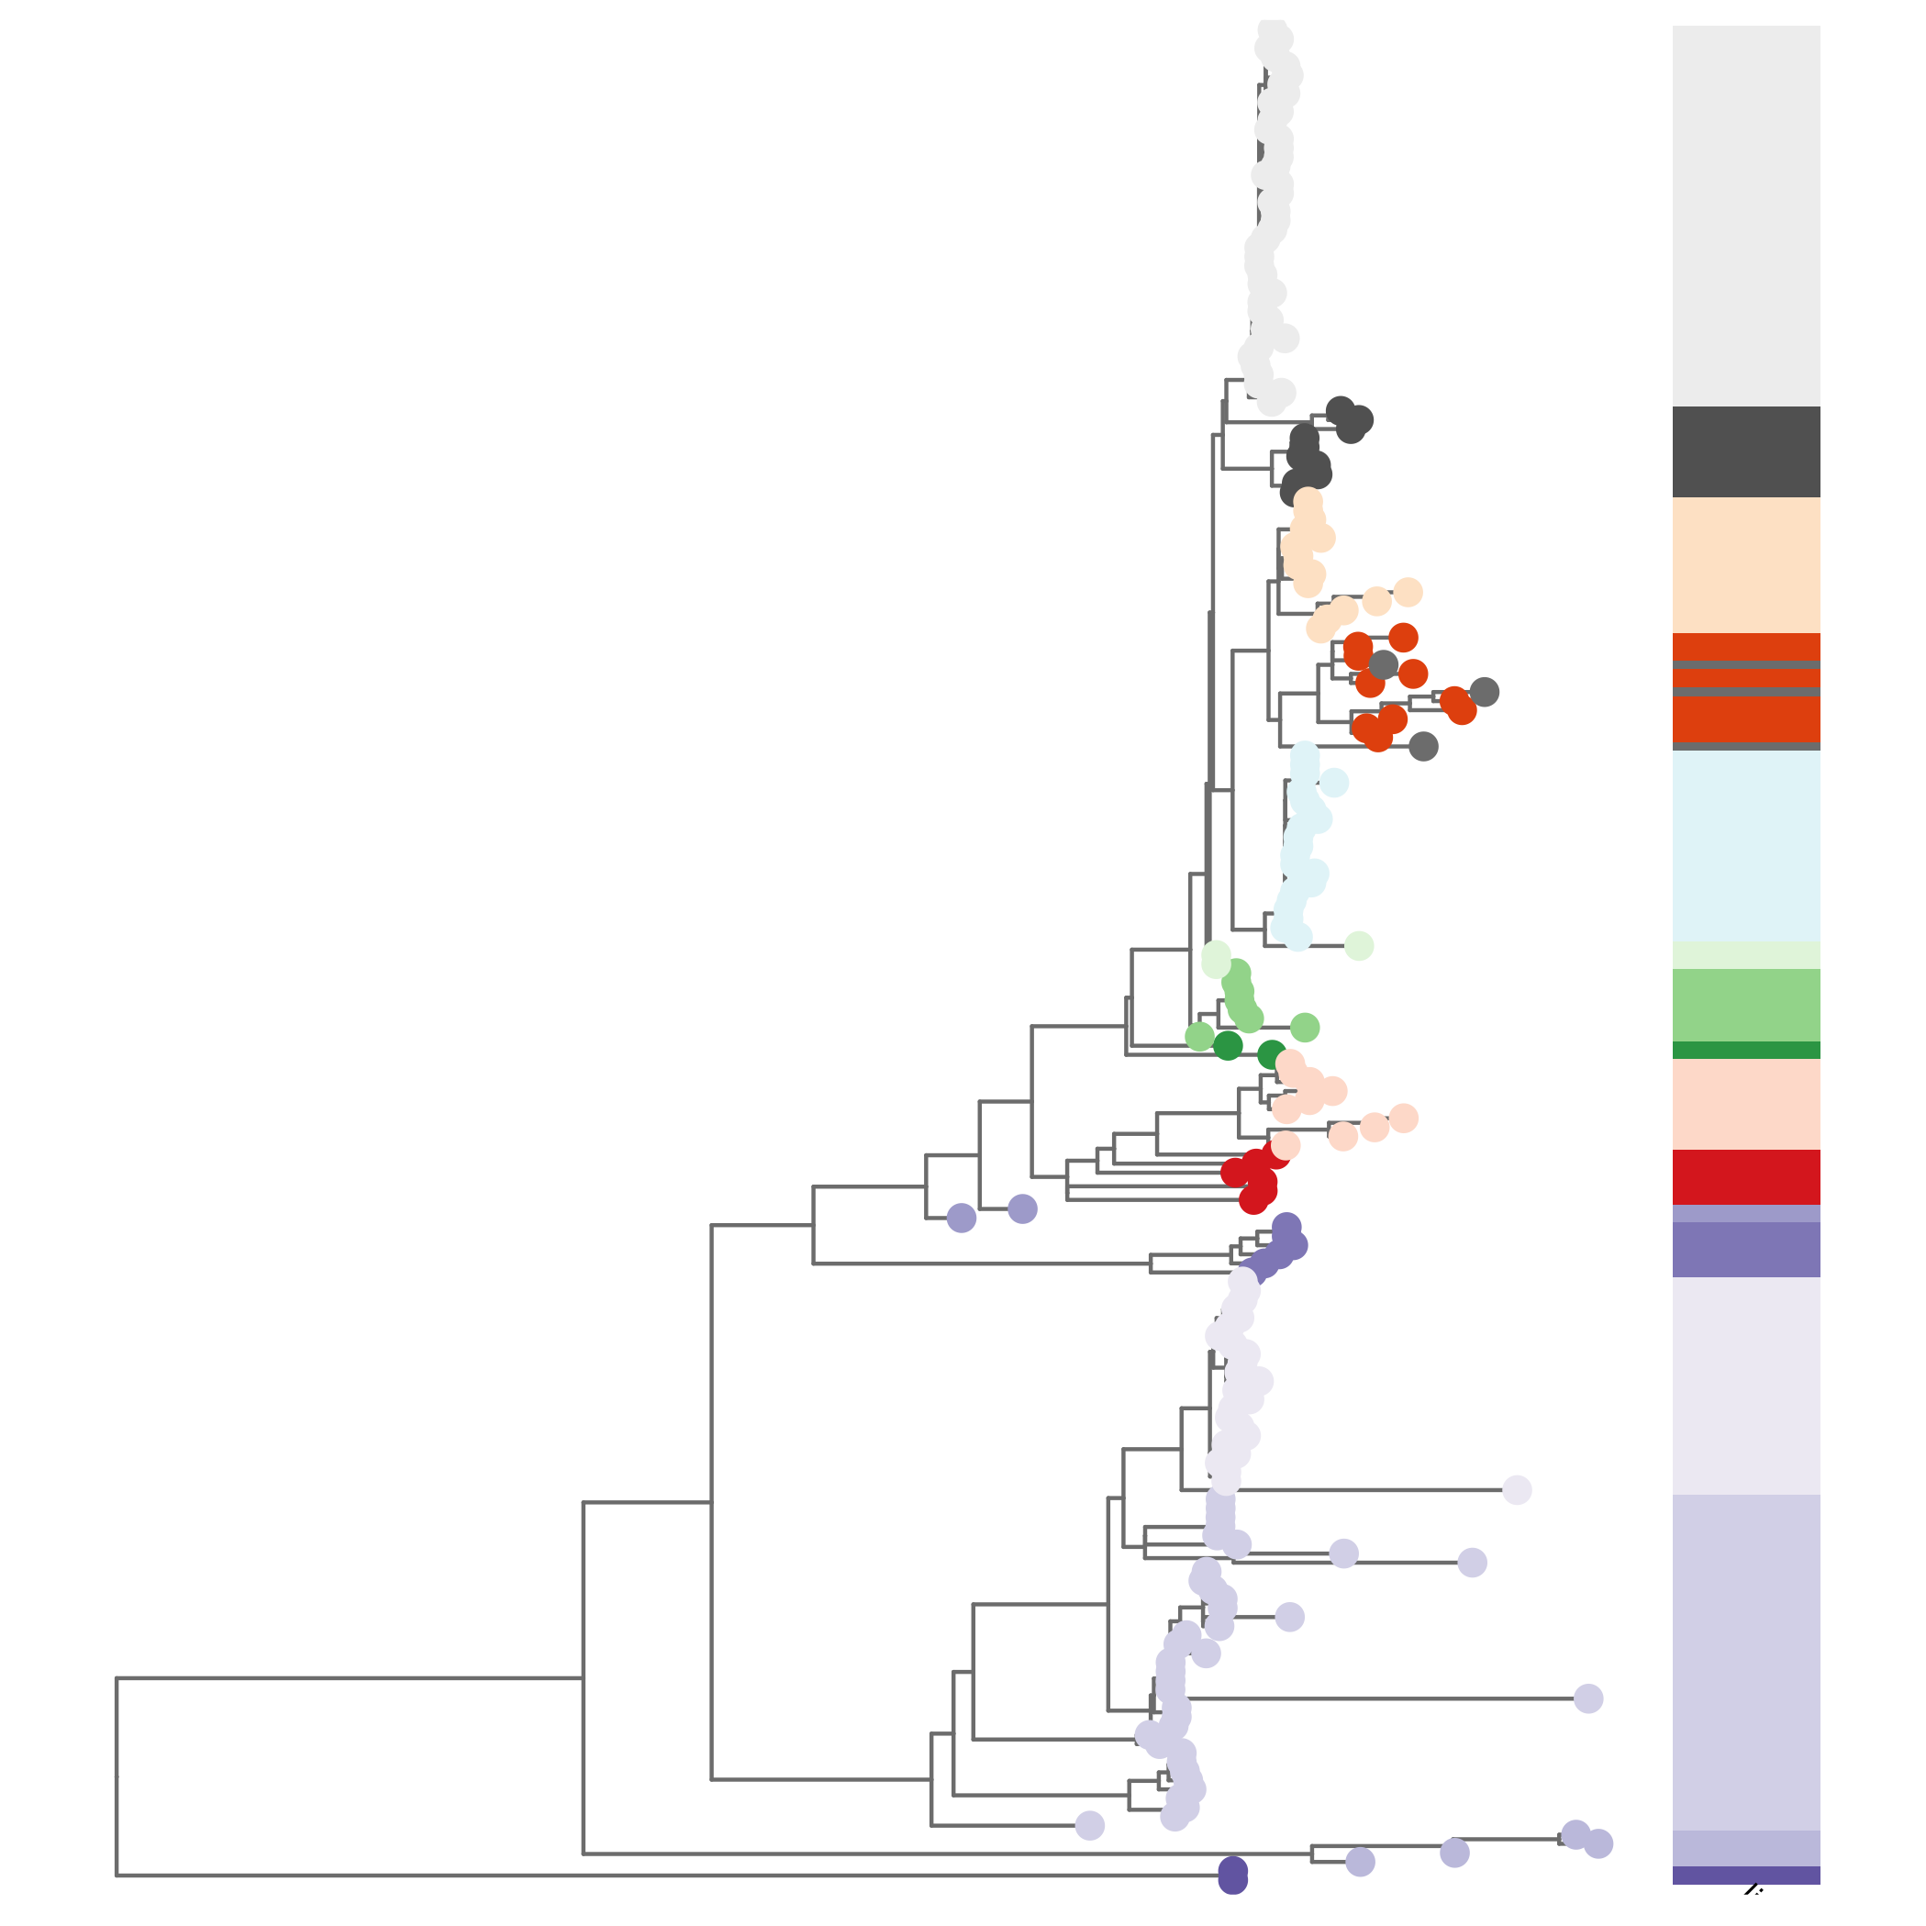
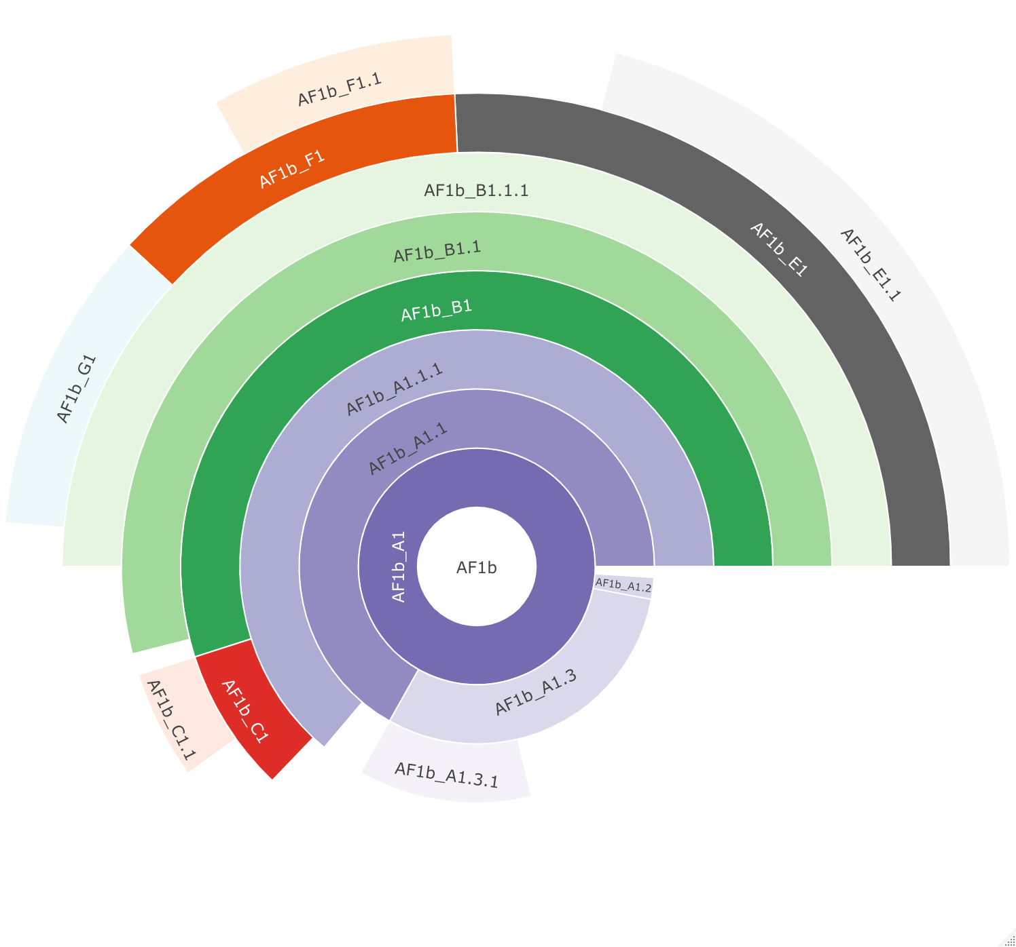
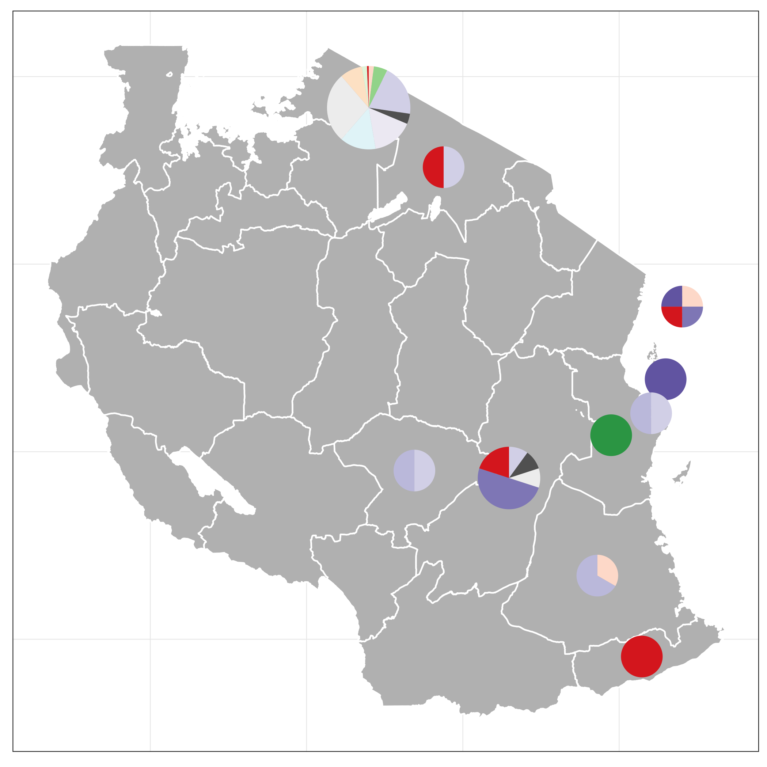
b)
a)
c)
Notes:
Figure 9 - Lineage designation of the 205 whole genome (10,000nt) rabies virus sequences from Tanzania, obtained from RABV-GLUE. A) Maximum likelihood tree showing the lineage positions with terminal lineages collapsed. B) Hierarchical relationships of the lineages.

Slide 11
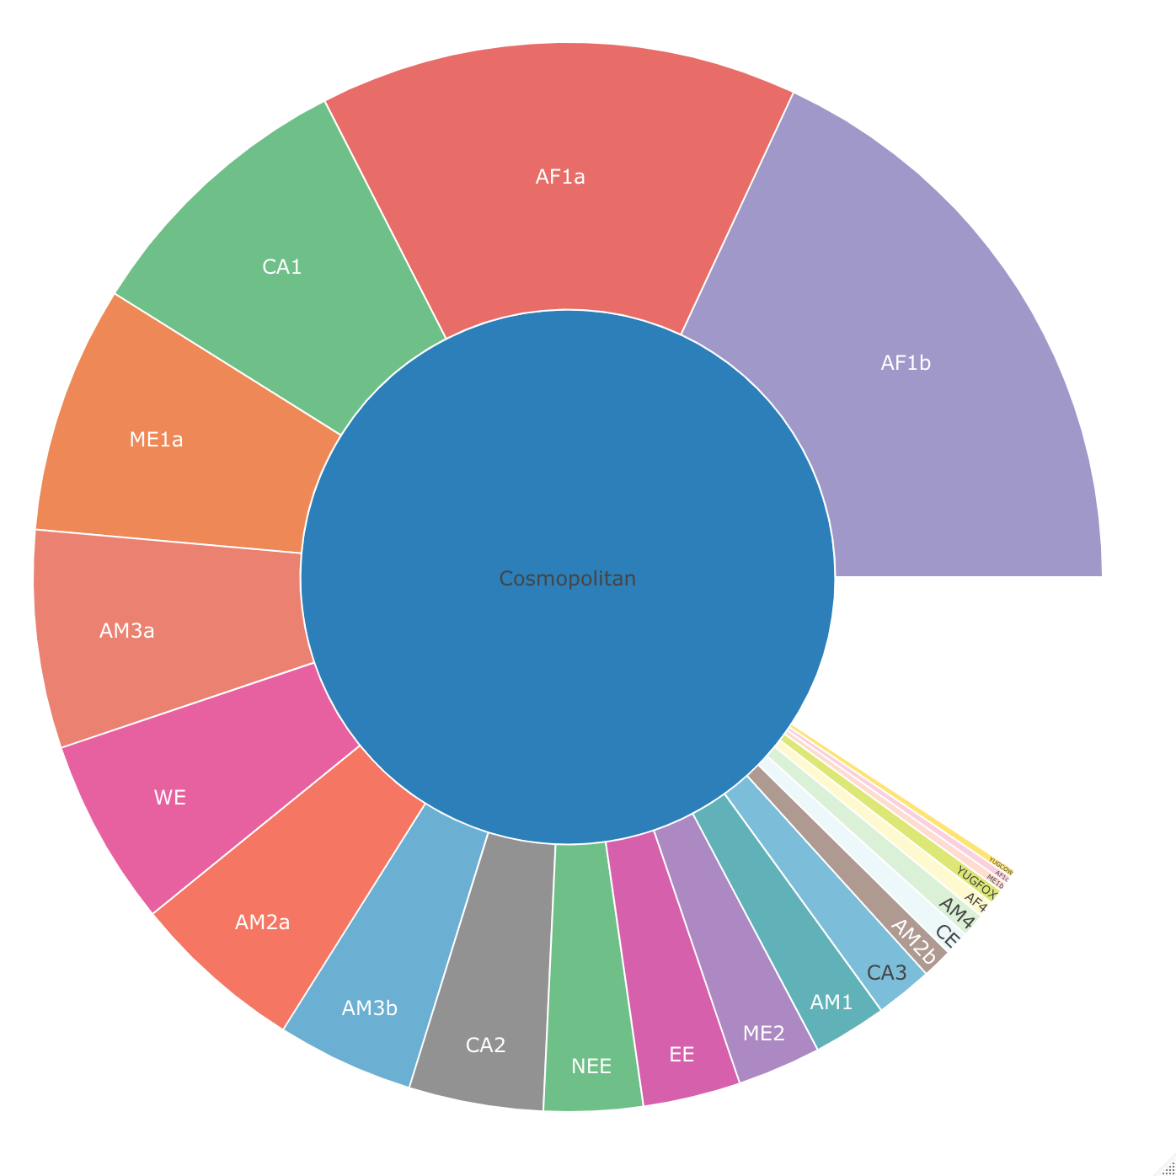
Cosmopolitan
Notes:
Fig10: Hierarchal relationship of the 23 existing subclades of the cosmopolitan clade

